Slide 1
ZS Campus Beats 2021 Case Challenge
This document is solely for the use of client personnel. No part of it may be circulated, quoted or reproduced for distribution outside of the client organization without prior written approval of ZS.

Slide 2
Team details
Team Name | DIVERGENT
College Name | Indian Institute of Technology Guwahati
Team Leader | Tathagata Bhowmik
Team Member 2 | Nilay Pandey
Team Member 3 | Hrithik Kumar Verma

Slide 3
scenario One – Business Consulting

Slide 4
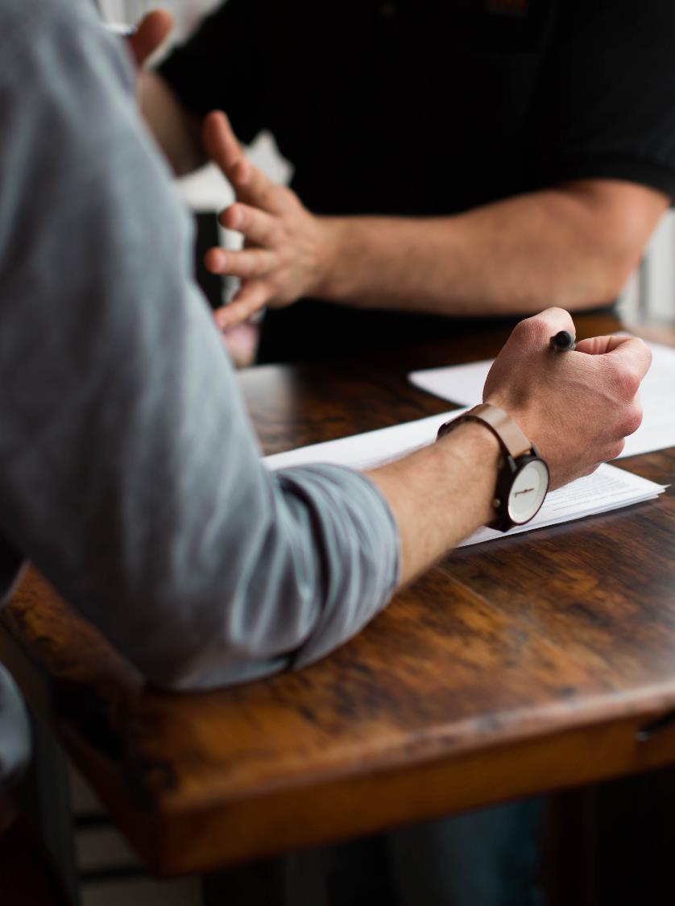
Business Consulting
OVERVIEW
01
Pulse Beverages, a leading nutrition drink manufacturer and seller in the US and India has introduced its unique drink Aqua. With the rising revenue, the company is concerned about its rising marketing costs.
02
ZS has been approached by the company to optimize their promotional costs and ensure that they are able to reach out to maximum customers via their preferred channels.
4

Slide 5
Part 1
Q1.1 Priority of channels based on net profit margin.
WEBSITE DISPLAY
Through website distribution channel net profit margin of 87.76% was obtained.
TV ADDS
Through Tv adds net profit margin of 86.92% was obtained..
PRINT ADDS
Through Print adds net profit margin of 86.68%.was obtained.
DEPT. 3
SOCIAL MEDIA
Though Social media net profit margin 85.21% was obtained..
DEPT. 4
EVENTS
Through various events net profit margin of 73.99% was obtained.

Slide 6
Part 1
SOCIAL MEDIA
TV ADDS
WEBSITE
Question 1.2(A)
On Observing the data from ratings chart and the data we got from net profit margin values, we multiplied both accessibility and popularity rating of the channel with their respective net profit margin value and then found out the top 3 channels based on that.
CHANNELS | SCORE
TV ADDS | 4867.68
PRINT ADDS | 2600.55
WEBSITE DISPLAY | 3159.43
SOCIAL MEDIA | 7668.52
EVENTS | 887.93

Slide 7
Part 1
Question 1.2(B) Key points for designing content for different channels.
1.
Due to the covid scenario digital media has seen a boost like never before, and it will continue to do so in near future.
2.
All the top three channels chosen will not get affected by covid, and is an excellent tool for the future in regards with new normal.
Advertising content should be designed in such a way that, it incorporates all the covid health measures.
3.

Slide 8
Part 2
REGION | RELEVANT POPULATION(IN 1000S) | CURRENT CUSTOMERS(IN 1000s)
1 | 54230 | 34707
2 | 92800 | 36192
3 | 86400 | 29376
LEAD CONVERSION %
63.99
39
34
Question 2.1
Based on the analysis .Region 2 will be the region with maximum opportunity owing to fact that it has the highest number of lead customer and also maximum market share which indicate more future growth.
Question 2.2
For S1 segment – Advertisement aired during Tv series at 5 to 7pm with short length is recommended.
For S2 segment – Advertisement aired during sports event of any length is preferred.
For S3 segment – In 5 to 7 pm time duration adds during movies or tv series adds with short length, in 7 to 10 pm adds sired during sports event, and from 1-0 to 12 adds aired during cartoons..
For S4 segment – From 7 to 10pm adds aired during sports event with short length and from 10 to 12 pm adds during cartoon event.
Now for one advertisement to be aired broadly, we tried to analyze it based on time so,
From 5 to 7 pm – Maximum engagement is of adds aired during TV series.
From 7 to 10 pm – Maximum engagement is of adds aired during sports events..
From 10 to 12 pm – Also adds aired during sports event.
Hence from above analysis it is concluded that adds aired during sports event should be best choice to air broadly.
ADVERTISEMENT # | S1 | S2 | S3 | S4
13 | 0 | 0 | 1 | 0
14 | 0 | 1 | 0 | 0
15 | 0 | 0 | 1 | 1

Slide 9
Part 2
Type of Product
Channels for promotion
Segment
Content and Messaging
We can optimize promotional cost on the basis of market share of the different product type.
Focus more on digital channels for promotion, as it helps in reducing promotional cost as well as keeping in mind covid scenario.
Target specific age group segment with specific media which they prefer.
Content should be made in accordance with new normal and precautionary message should be there.
Q2.3 Promotional strategies for new product.

Slide 10
Part 3
Q3.1 and 3.2
Website
Print
TV
Revenue (millions) | ROI
5 | 5
10 | 5
15 | 5
20 | 5
22.5 | 4.5
30 | 5
32.5 | 4.64
40 | 5
40 | 4.44
40 | 4
45,3,2
Revenue (millions) | ROI
0 | 0
10 | 0.4
80 | 2.66
150 | 4.28
200 | 5
270 | 6
300 | 6
320 | 5.81
320 | 5.33
320 | 4.92
Revenue (millions) | ROI
10 | 4
15 | 5
20 | 5
25 | 5
35 | 5.833
40 | 5.71
40 | 5
40 | 4.44
40 | 4
40 | 3.63
This should be the optimal promotional spend (millions) for the top 3 channels Website, Print, TV respectively.
50
This is the maximum promotional budget in millions.
295
This is the maximum revenue generated by using optimal promotional strategy mentioned above.

Slide 11
Part 3
Age-Groups | Preferred Media | % of weekly time
Children | Tv | 56.6
Young Corporate | Browsing internet and social media | 80
Mid to senior | Tv | 36.36
Senior | Print | 54.54
Question 3.3
On analysis it was concluded that the strategy of not targeting specific customer segment with specific channel should be changed as each segment has their own specific distribution channel which they prefer more over other, hence targeting with those specific channels only could help to decrease promotional cost which was first being used over other age groups and hence increase profitability.

Slide 12
THANK YOU! ☺

